Slide 1

Dodget ML
A project by Lorenzo Galasso, Francesco Galasso e Oscar Granese

Slide 2
Game features
DodGet is a video game based on the player's ability to avoid obstacles and maximize their score.
The player moves around a square area where there is always a coin to collect.
Every time the player collects a coin, their score increases by 1 and a fireball is generated to avoid.
If the player collects a certain number of coins he can use a "bomb" to clear an area around him.

Slide 3
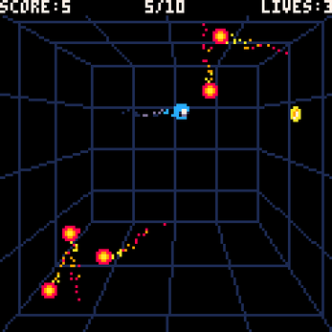
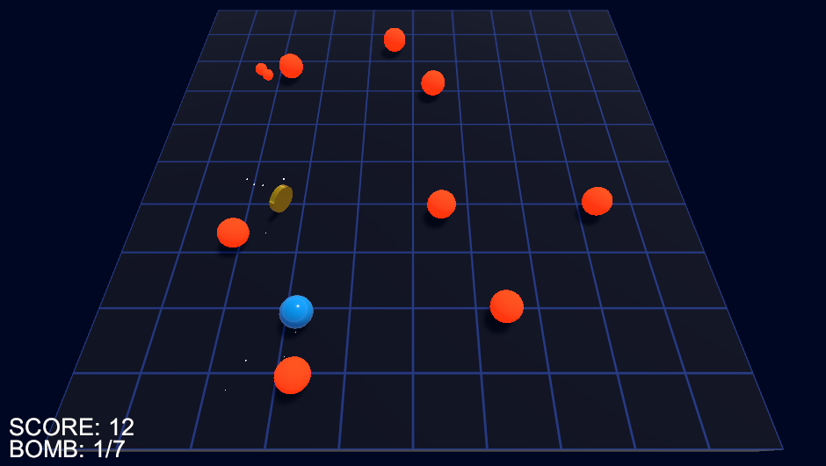
Game screen
Original game, made in LUA with the Pico-8 game engine.
Transposition of the game into the Unity environment, created for the project.

Slide 4
characteristics of the agent
Creation of an Agent capable of playing DodGet automatically and obtaining a satisfactory score
The Agent must also be capable of using the bombs at his disposal

Slide 5
Used technologies
ML Agents 19
Unity: 2020.3.40f1
Unity ML Agents package: 2.2.1-exp.1
Python: 3.8.2
Pytorch: 1.8.1+CPU
Tensorflow: 2.11.0

Slide 6
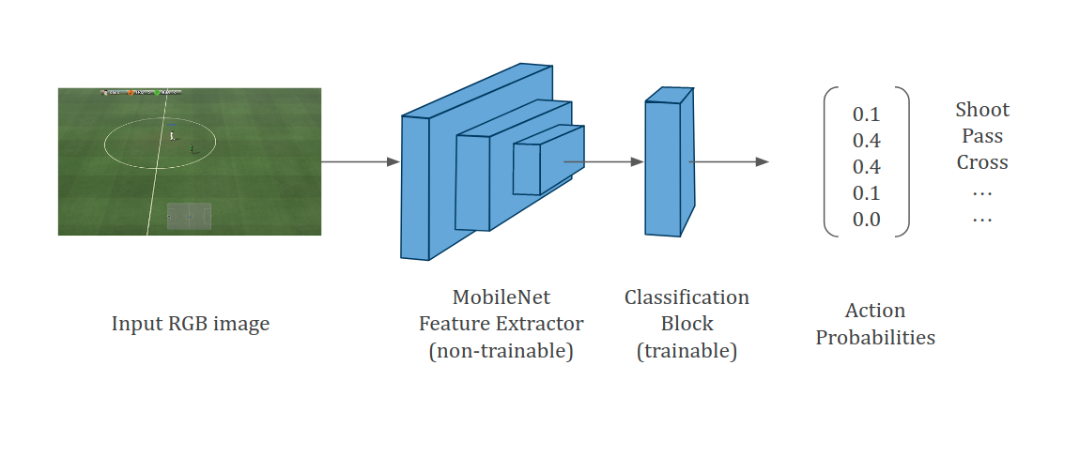
Training model
The model chosen for our agent's training was the standard one present in ML Agents or Proximal Policy Optimization (PPO), an algorithm for Reinforcement Learning (RL) in complex environments.
This is a type of on-policy optimization algorithm, meaning it uses the same data to both improve the policy and evaluate it. PPO is known for its simplicity, stability and high performance.

Slide 7
Training specifics
The training of the Agent was carried out on two different machines and with 20 concurrent instances.
The training was concluded at 22 and a half million steps because it no longer showed visible improvements.
A brain improvement check was carried out approximately every 3 million steps.

Slide 8

Machines used for learning
The Agent learning process was carried out using two separate machines with the following characteristics:
The first one:
Processor: Intel Core i5 9600k
GPU: Nvidia Geforce GTX 1660 Super
The second one:
Processor: Intel Core I5 3540k
GPU: Nvidia Geforce GTX 1050Ti

Slide 9
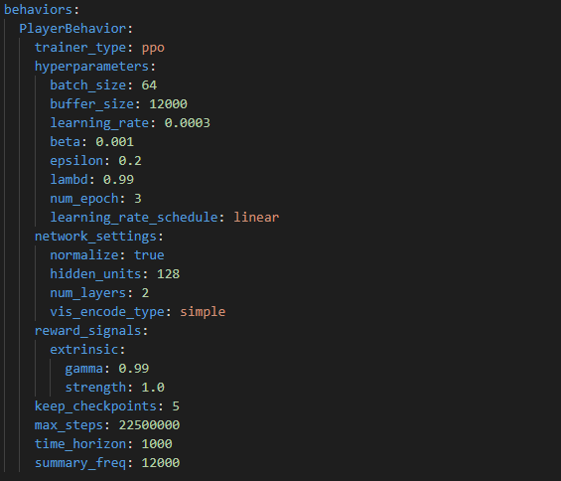
YAML Configuration

Slide 10
Reward System
The rewards for the agent have been defined based on the game elements with which it can interact:
Coins
Fireballs
Bomb Action
A reward system has also been added for the player's collision with the walls that delimit the area in which he can move, to optimize his training.

Slide 11

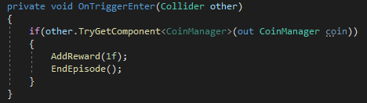
Reward system - Coins
Since the coin is the main game element to increase your score, a reward equal to 1 was immediately assigned to it.
This reward remained unchanged for the entire duration of the training.

Slide 12
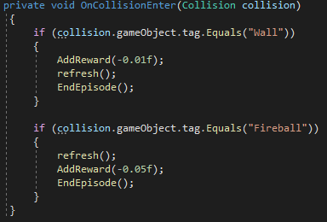

Reward system – obstacles
Fireballs were initially given a –1 penalty.
This penalty was then decreased to –0.01 to encourage the Agent to continue with matches even after a defeat.
Finally, –0.05 was established as the definitive value of the penalty received by the player every time he hits a fireball.

Slide 13


Reward system - bomb
Using the bomb adds an element of strategy to the game.
It was therefore decided to regulate the rewards so that it is not wasted by the Agent, but rather used wisely to eliminate a fair number of obstacles.
Initially a reward of 0.05 was awarded for each of the fireballs eliminated.
Later, to optimize the agent's decisions, it was established that this reward would only be earned if the Agent eliminated a number greater than or equal to 1/3 of the total number of fireballs present on the scene.

Slide 14
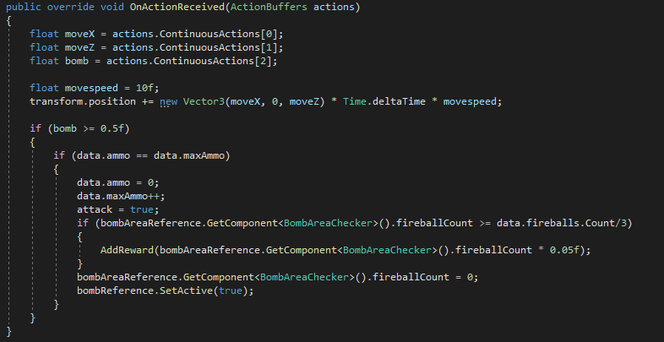
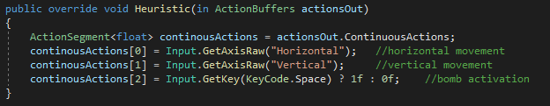
Design idea – player actions

Slide 15
Initial design idea
The idea was to make the Agent able to see walls, fireballs and coins and to aim for the coins and avoid the other two elements.
Also to manage everything with observations.
The walls would destroy the Agent on contact.
Episodes end whenever the Agent comes into contact with an object.

Slide 16
Changes made during design
Changed the viewing model for the Agent by replacing some observations with Raycast 3D.
The wall provides only negative rewards and does not reset the Agent's position.
Not all interactions complete the episode (the bomb only adds rewards).

Slide 17
TensorBoard
TensorBoard is a data visualization and machine learning model tool provided by TensorFlow.
In a project with ML-Agents, TensorBoard can be used to visualize and monitor the training data and performance of the AI ​​model.
With TensorBoard, you can view different training metrics, such as model accuracy or error rate. This allows you to monitor how the model is learning and identify any problems or opportunities for improvement.

Slide 18
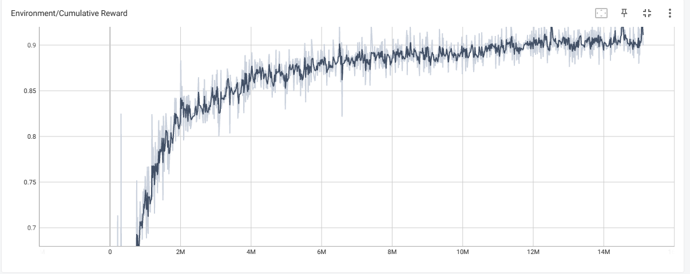
Cumulative Reward

Slide 19
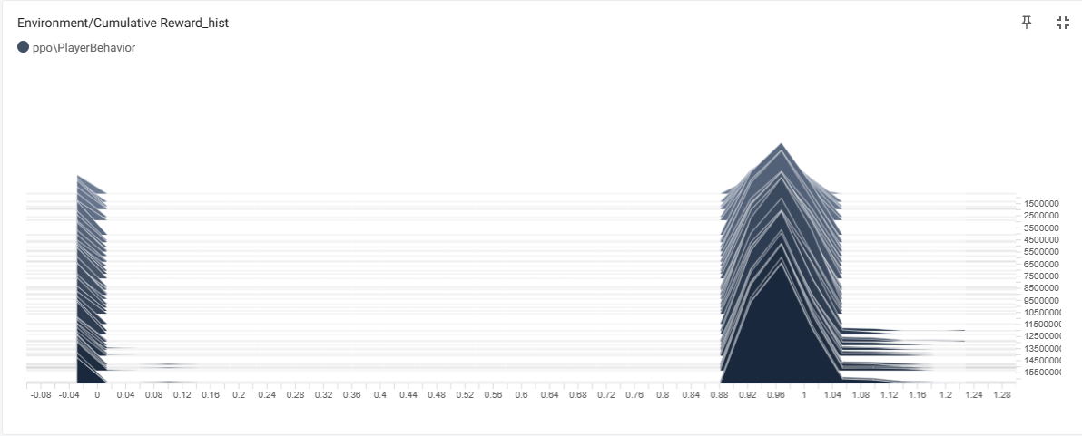
Reward history

Slide 20
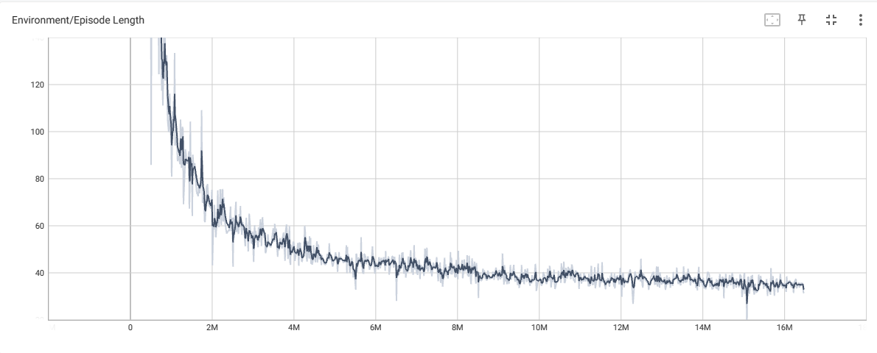
Episode Length

Slide 21
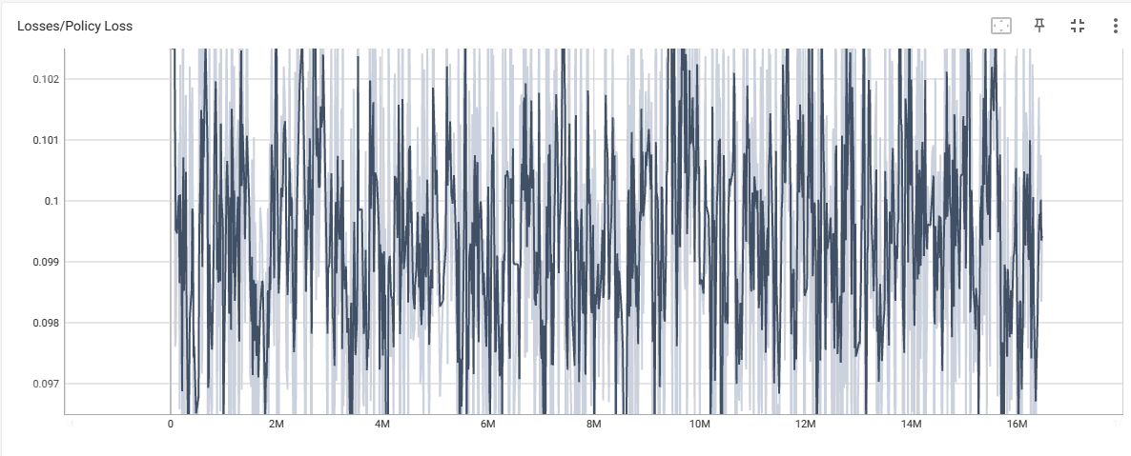
Policy Loss

Slide 22
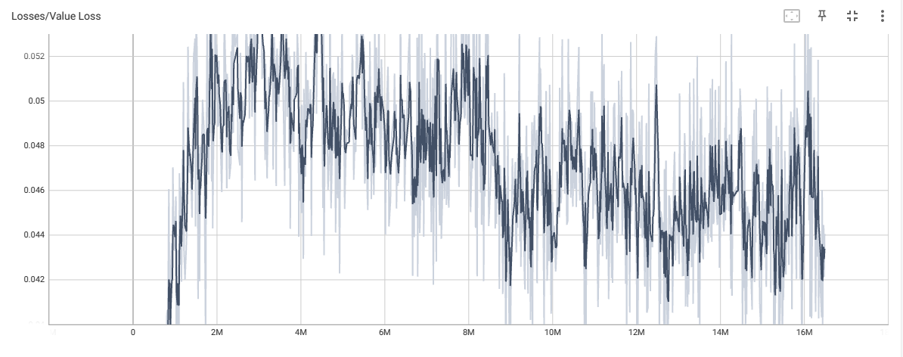
Value loss

Slide 23
Results
Based on the rewards assigned to the elements of the scene, it was possible to train the Agent satisfactorily in avoiding a number of obstacles which, due to the nature of the game, tend to increase constantly.
The use of the bomb sometimes presents uncertainties.
Some random events can negatively impact the game such as fireballs spawning adjacent to the Agent.

Slide 24

Thank you for your attention

